Slide 1

Project #1
By: Kerin Quintero
A-I & K-O

Slide 2
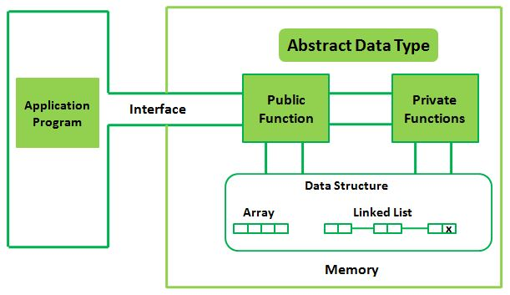
Abstract Data Type/Definition
A type of class that defines specific types of values that can include list, and stacks.

Slide 3
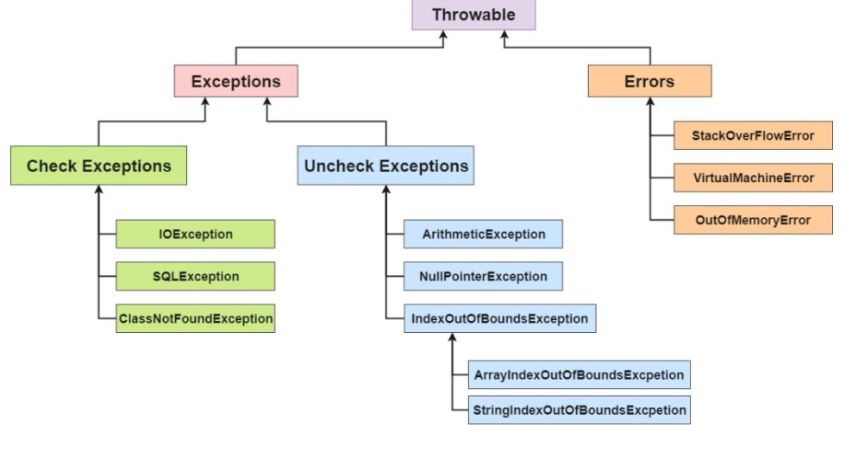
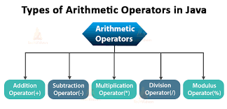
Arithmetic exception
When attempts are made by diving two numbers and the denominator is zero

Slide 4
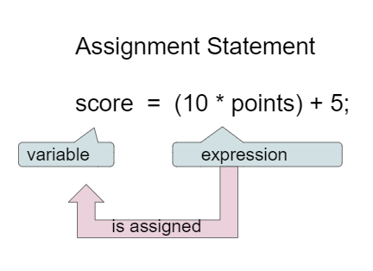
Assignment statement
This is an expression that evaluates a value that is assigned to a variable but only on the left side of the assignment operator. Where are the value of the expression ends up on the right side of the operator.

Slide 5
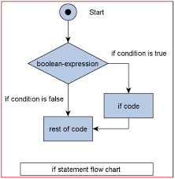
Boolean/Definition
This is called a primitive data type, which is used to store only 2 values, that can be either true or false.
or
true
false

Slide 6
Camel Case /defintion
Camel case is basically used to join a majority of words by taking away white spaces and showing the uppercase letter to display boundary between the words.
Example:(myHouse)
Non example: (MyHouse)

Slide 7
Case sensitive/defintion
This programming language follows a case sensitive rule, that will not count if the variable used for variables that are upper case.
('K')
('k')
=different case

Slide 8
Casting a Variable/definitoin
Changing the type of a variable using (type) name.
Int IntCash=
(int) DoubleCash;

Slide 9
Concatenate/definition
Its string class process takes the value of string adding/joining it to the current string and provides the result.
String#1
"kerin";
String#2
"quintero";
Concantenate result
"kerin quintero";

Slide 10
Constant /defintion
Constant is a variable which value does not change after being assigned a value.
Data type/integer
byte
int
Float point
double
float

Slide 11
Data type/definition
This specifies the different values that can be stored in the variable, examples of data types can include, char, double, int, float, and boolean.
Constant
int
string
Types
real
char

Slide 12
Declaration
In order to declare a variable, you must create the exact type of variable .
Char type
'P';
'S';
'I;'
'0';

Slide 13
Declare a Variable
This specifies the type of variable that must be declared before running and can be changed. The variable is just a name given to a memory location, doing this will affect that memory.
Int = datatype
age=23; =value
=stores variable memory

Slide 14
Double
A data type that holds the place of values with a decimal point
Example: double -2.45;
Double=datatype
Exactheight=
64.7 in.

Slide 15
Equal sign (=)
The equal sign is an operator that sits in the middle of the variable and what it values. This shows that equal they equal each other.
String#1
String#2
Equals==

Slide 16
Exception
Exception is the event that happens while a program is executing and stops how it would normally function.
checked
Runtime
exception
errors
Throwable

Slide 17
Floating point
Floating points are numbers that have fractional parts, this would be used when needing numbers that would include a decimal.
Float
b
45.789f

Slide 18
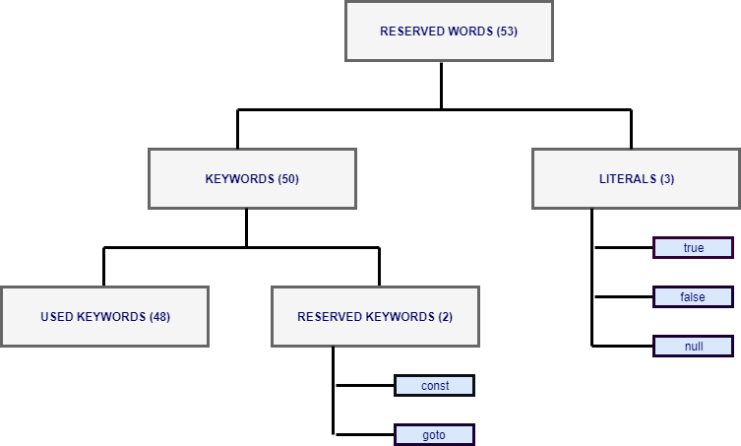
Keyword
Keywords are different terms that serves as a code key, so because java defines words they can be used as variable or class names.

Slide 19
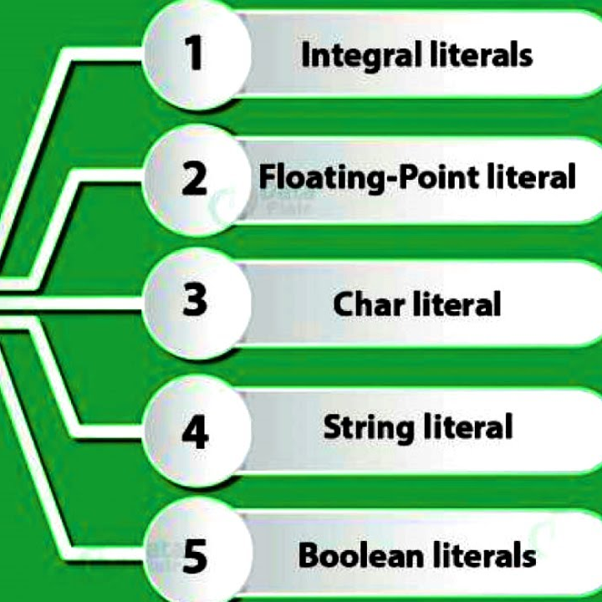
Literal
This could represent numeric, char, string, and boolean. This is just an expression of certain values in a program.

Slide 20
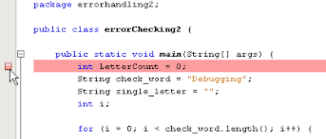
Logic error /definition
A logic error ,is known as a bug which happens when your software operates and take actions incorrectly.

Slide 21
21. Modulus division & 22.Modulus/ definition
After division the modulus or remainder will provide the remaining of the two numbers.
X%y
X-(x/y)*y
18%3
18-(18/3)*3
18-(3)*3
18-3

Slide 22
Object
Using class, creates objects that represents sets of properties or methods of one type.
Card ID
identifiers
Bowiestate University
Students
names
Student ID

Slide 23
Operator precedence
This is the order in which the operators in an expression are evaluated is determined by an operator precedence.
5
10+ operator lower
5/division higher
3=

Slide 24
Operator
Operators are mathematical symbols used to preform operations like addition, division, etc.
3
1+ addition
2=
6
3* multiplication
2=
10
30/
3=

